Slide 1
Chapter 2:
Elementary
Data
Structures

Slide 2
Example
Spelling checker
  Need to look up words in a list of correctly-spelled words
  How to implement?
Operations needed?
  Insert
  Find
  Delete
    Called ADT Dictionary
How to implement?

Slide 3
Abstract Data Types (ADTs)
An abstract data type (ADT) is an abstraction of a data structure
An ADT specifies:
  Data stored
  Operations on the data
  Error conditions associated with operations
An ADT is implemented with various concrete data structures
Example: ADT modeling a simple stock trading system
  The data stored are buy/sell orders
  The operations supported are
    order buy(stock, shares, price)
    order sell(stock, shares, price)
    void cancel(order)
  Error conditions:
    Buy/sell a nonexistent stock
    Cancel a nonexistent order

Slide 4
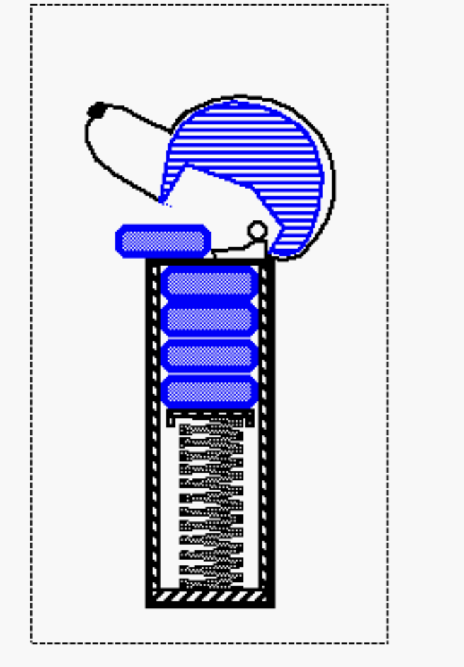
Chapter 2.1-2.4:
Elementary Data Structures
Introduction
Stacks
Queues
Lists and Sequences
Trees

Slide 5
Example
Problem: Managing Call Frames
ADT?
Implementation?

Slide 6

The Stack ADT (§2.1.1)
The Stack ADT stores arbitrary objects
Insertions and deletions follow the last-in first-out scheme
Think of a spring-loaded plate dispenser
Main stack operations:
  push(object): inserts an element
  object pop(): removes and returns the last inserted element
Auxiliary stack operations:
  object top(): returns the last inserted element without removing it
  integer size(): returns the number of elements stored
  boolean isEmpty(): indicates whether no elements are stored

Slide 7
Exceptions
Attempting the execution of an operation of ADT may sometimes cause an error condition, called an exception
Exceptions are said to be “thrown” by an operation that cannot be executed
In the Stack ADT, operations pop and top cannot be performed if the stack is empty
Attempting the execution of pop or top on an empty stack throws an EmptyStackException

Slide 8

Applications of Stacks
Direct applications
  Page-visited history in a Web browser
  Undo sequence in a text editor
  Chain of method calls in the Java Virtual Machine or C++ runtime environment
Indirect applications
  Auxiliary data structure for algorithms
  Component of other data structures

Slide 9

Method Stack in the JVM
main() {
int i = 5;
foo(i);
}
foo(int j) {
int k;
k = j+1;
bar(k);
}
bar(int m) {
…
}
The Java Virtual Machine (JVM) keeps track of the chain of active methods with a stack
When a method is called, the JVM pushes on the stack a frame containing
  Local variables and return value
  Program counter, keeping track of the statement being executed
When a method ends, its frame is popped from the stack and control is passed to the method on top of the stack
bar
PC = 1
m = 6
foo
PC = 3
j = 5
k = 6
main
PC = 2
i = 5

Slide 10
Array-based Stack (§2.1.1)
Algorithm pop():
if isEmpty() then
throw EmptyStackException
else
t ← t − 1
return S[t + 1]
A simple way of implementing the Stack ADT uses an array
We add elements from left to right
A variable t keeps track of the index of the top element (size is t+1)
Algorithm push(o)
if t = S.length − 1 then
throw FullStackException
else
t ← t + 1
S[t] ← o
…
S
0
1
2
t

Slide 11

Growable Array- based Stack (§1.5)
In a push operation, when the array is full, instead of throwing an exception, we can replace the array with a larger one
How large should the new array be?
  incremental strategy: increase the size by a constant c
  doubling strategy: double the size
Algorithm push(o)
if t = S.length − 1 then
A ← new array of
size …
for i ← 0 to t do
A[i] ← S[i]
S ← A
t ← t + 1
S[t] ← o

Slide 12
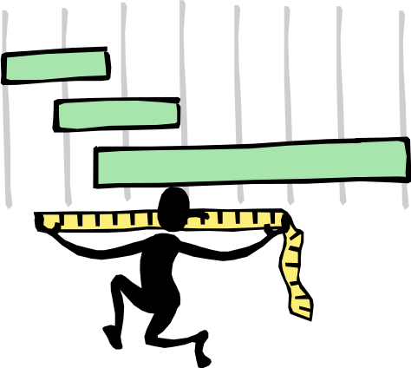
Comparison of the Strategies
We compare the incremental strategy and the doubling strategy by analyzing the total time T(n) needed to perform a series of n push operations
We assume that we start with an empty stack represented by an array of size 1
We call amortized time of a push operation the average time taken by a push over the series of operations, i.e., T(n)/n

Slide 13

Analysis of the Incremental Strategy
We replace the array k = n/c times
The total time T(n) of a series of n push operations is proportional to
n + c + 2c + 3c + 4c + … + kc =
n + c(1 + 2 + 3 + … + k) =
n + ck(k + 1)/2
Since c is a constant, T(n) is O(n + k²), i.e., O(n²)
The amortized time of a push operation is O(n)

Slide 14
Direct Analysis of the Doubling Strategy
We replace the array k = log₂ n times
The total time T(n) of a series of n push operations is proportional to
n + 1 + 2 + 4 + 8 + …+ 2^{k} =
n + 2^{k + 1} −1 = 2n −1
T(n) is O(n)
The amortized time of a push operation is O(1)
geometric series
2
4
1
1
8

Slide 15


Accounting Method Analysis of the Doubling Strategy
The accounting method determines the amortized running time with a system of credits and debits
We view a computer as a coin-operated device requiring 1 cyber-dollar for a constant amount of computing.
  We set up a scheme for charging operations. This is known as an amortization scheme.
  The scheme must give us always enough money to pay for the actual cost of the operation.
  The total cost of the series of operations is no more than the total amount charged.
(amortized time) ≤ (total $ charged) / (# operations)

Slide 16

Amortization Scheme for the Doubling Strategy
Consider again the k phases, where each phase consisting of twice as many pushes as the one before.
At the end of a phase we must have saved enough to pay for the array-growing push of the next phase.
At the end of phase i we want to have saved i cyber-dollars, to pay for the array growth for the beginning of the next phase.
$
$
$
$
$
$
$
$
$
$
0
1
2
3
4
5
6
7
0
1
2
3
4
5
6
7
8
9
10
11
12
13
14
15
We charge $3 for a push. The $2 saved for a regular push are “stored” in the second half of the array. Thus, we will have 2(i/2)=i cyber-dollars saved at then end of phase i.
Therefore, each push runs in O(1) amortized time; n pushes run in O(n) time.

Slide 17
Example
Problem: Managing Homework Grading
ADT?
Implementation?

Slide 18
Queues
Queues

Slide 19

The Queue ADT (§2.1.2)
The Queue ADT stores arbitrary objects
Insertions and deletions follow the first-in first-out scheme
Insertions are at the rear of the queue and removals are at the front of the queue
Main queue operations:
  enqueue(object): inserts an element at the end of the queue
  object dequeue(): removes and returns the element at the front of the queue
Auxiliary queue operations:
  object front(): returns the element at the front without removing it
  integer size(): returns the number of elements stored
  boolean isEmpty(): indicates whether no elements are stored
Exceptions
  Attempting the execution of dequeue or front on an empty queue throws an EmptyQueueException

Slide 20
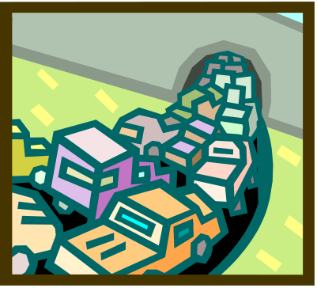
Applications of Queues
Direct applications
  Waiting lines
  Access to shared resources (e.g., printer)
  Multiprogramming
Indirect applications
  Auxiliary data structure for algorithms
  Component of other data structures

Slide 21
Singly Linked List
next
A singly linked list is a concrete data structure consisting of a sequence of nodes
Each node stores
  element
  link to the next node
elem
node
∅
A
B
C
D

Slide 22




Queue with a Singly Linked List
We can implement a queue with a singly linked list
  The front element is stored at the first node
  The rear element is stored at the last node
The space used is O(n) and each operation of the Queue ADT takes O(1) time
r
nodes
f
∅
elements

Slide 23
Example
Problem: Netflix Queue
ADT?
Implementation?

Slide 24

List ADT (§2.2.2)
The List ADT models a sequence of positions storing arbitrary objects
It allows for insertion and removal in the “middle”
Query methods:
  isFirst(p), isLast(p)
Accessor methods:
  first(), last()
  before(p), after(p)
Update methods:
  replaceElement(p, o), swapElements(p, q)
  insertBefore(p, o), insertAfter(p, o),
  insertFirst(o), insertLast(o)
  remove(p)

Slide 25
Doubly Linked List
A doubly linked list provides a natural implementation of the List ADT
Nodes implement Position and store:
  element
  link to the previous node
  link to the next node
Special trailer and header nodes
prev
next
elem
node
header
nodes/positions
trailer
elements

Slide 26
Example
Problem: Parsing an arithmetic expression
  (1 + 2 + 2 ^ (2 + 2) * 2 + 2) * 3 = ?
Desired result?
Algorithm?

Slide 27

Trees
Make Money Fast!
Stock
Fraud
Ponzi
Scheme
Bank
Robbery

Slide 28
Trees (§2.3)
In computer science, a tree is an abstract model of a hierarchical structure
A tree consists of nodes with a parent-child relation
Applications:
  Organization charts
  File systems
  Programming environments
Computers”R”Us
Sales
Manufacturing
R&D
US
International
Laptops
Desktops
Europe
Asia
Canada

Slide 29
Tree Terminology
Root: node without parent (A)
Internal node: node with at least one child (A, B, C, F)
External node (a.k.a. leaf): node without children (E, I, J, K, G, H, D)
Ancestors of a node: parent, grandparent, grand-grandparent, etc.
Depth of a node: number of ancestors
Height of a tree: maximum depth of any node (3)
Descendant of a node: child, grandchild, grand-grandchild, etc.
Subtree: tree consisting of a node and its descendants
A
B
C
D
E
F
G
H
subtree
I
J
K

Slide 30

Tree ADT (§2.3.1)
We use positions to abstract nodes
Generic methods:
  integer size()
  boolean isEmpty()
  objectIterator elements()
  positionIterator positions()
Accessor methods:
  position root()
  position parent(p)
  positionIterator children(p)
Query methods:
  boolean isInternal(p)
  boolean isExternal(p)
  boolean isRoot(p)
Update methods:
  swapElements(p, q)
  object replaceElement(p, o)
Additional update methods may be defined by data structures implementing the Tree ADT

Slide 31
Preorder Traversal
A traversal visits the nodes of a tree in a systematic manner
In a preorder traversal, a node is visited before its descendants
Application: print a structured document
Algorithm preOrder(v)
  visit(v)
  for each child w of v
  preorder (w)
1
Make Money Fast!
2
5
9
1. Motivations
2. Methods
References
3
4
6
7
8
1.1 Greed
1.2 Avidity
2.1 Stock
Fraud
2.2 Ponzi
Scheme
2.3 Bank
Robbery

Slide 32
Postorder Traversal
In a postorder traversal, a node is visited after its descendants
Application: compute space used by files in a directory and its subdirectories
Algorithm postOrder(v)
  for each child w of v
  postOrder (w)
  visit(v)
9
cs16/
8
3
7
homeworks/
programs/
todo.txt
1K
1
2
4
5
6
h1c.doc
3K
h1nc.doc
2K
DDR.java
10K
Stocks.java
25K
Robot.java
20K

Slide 33

Amortized Analysis of Tree Traversal
Time taken in preorder or postorder traversal of an n-node tree is proportional to the sum, taken over each node v in the tree, of the time needed for the recursive call for v.
  The call for v costs $(c_{v} + 1), where c_{v} is the number of children of v
  For the call for v, charge one cyber-dollar to v and charge one cyber-dollar to each child of v.
  Each node (except the root) gets charged twice: once for its own call and once for its parent’s call.
  Therefore, traversal time is O(n).

Slide 34
Binary Trees (§2.3.3)
A binary tree is a tree with the following properties:
  Each internal node has two children
  The children of a node are an ordered pair
We call the children of an internal node left child and right child
Alternative recursive definition: a binary tree is either
  a tree consisting of a single node, or
  a tree whose root has an ordered pair of children, each of which is a binary tree
Applications:
  arithmetic expressions
  decision processes
  searching
A
B
C
D
E
F
G
H
I

Slide 35
Arithmetic Expression Tree
Binary tree associated with an arithmetic expression
  internal nodes: operators
  external nodes: operands
Example: arithmetic expression tree for the expression (2 × (a − 1) + (3 × b))
+
×
×
2
−
3
b
a
1

Slide 36
Decision Tree
Binary tree associated with a decision process
  internal nodes: questions with yes/no answer
  external nodes: decisions
Example: dining decision
Want a fast meal?
Yes
No
How about coffee?
On expense account?
Yes
No
Yes
No
Starbucks
Qdoba
Gibson’s
Russ’

Slide 37
Properties of Binary Trees
Notation
  n number of nodes
  e number of external nodes
  i number of internal nodes
  h height
Properties:
  e = i + 1
  n = 2e − 1
  h ≤ i
  h ≤ (n − 1)/2
  e ≤ 2^{h}
  h ≥ log₂ e
  h ≥ log₂ (n + 1) − 1

Slide 38
Inorder Traversal
In an inorder traversal a node is visited after its left subtree and before its right subtree
Application: draw a binary tree
  x(v) = inorder rank of v
  y(v) = depth of v
Algorithm inOrder(v)
  if v is not null
    inOrder (leftChild (v))
  visit(v)
    inOrder (rightChild (v))
6
2
8
1
4
7
9
3
5

Slide 39
Euler Tour Traversal
Generic traversal of a binary tree
Includes as special cases the preorder, postorder and inorder traversals
Walk around the tree and visit each node three times:
  on the left (preorder)
  from below (inorder)
  on the right (postorder)
+
L
×
R
×
B
2
−
3
2
5
1

Slide 40
Printing Arithmetic Expressions
Specialization of an inorder traversal
  print operand or operator when visiting node
  print “(“ before traversing left subtree
  print “)“ after traversing right subtree
Algorithm printExpression(v)
  if isInternal (v)
  print(“(’’)
    inOrder (leftChild (v))
  print(v.element ())
  if isInternal (v)
    inOrder (rightChild (v))
  print (“)’’)
+
×
×
2
−
3
b
((2 × (a − 1)) + (3 × b))
a
1

Slide 41
Linked Data Structure for Representing Trees (§2.3.4)
A node is represented by an object storing
  Element
  Parent node
  Sequence of children nodes
Node objects implement the Position ADT
∅
B
∅
∅
A
D
F
B
A
D
F
C
E
∅
∅
C
E

Slide 42
Linked Data Structure for Binary Trees
A node is represented by an object storing
  Element
  Parent node
  Left child node
  Right child node
Node objects implement the Position ADT
∅
B
∅
∅
B
A
D
A
D
∅
∅
∅
∅
C
E
C
E

Slide 43
Array-Based Representation of Binary Trees
nodes are stored in an array
1
A
…
2
3
B
D
let rank(node) be defined as follows:
  rank(root) = 1
  if node is the left child of parent(node), rank(node) = 2*rank(parent(node))
  if node is the right child of parent(node), rank(node) = 2*rank(parent(node))+1
4
5
6
7
E
F
C
J
10
11
G
H

Slide 44
Basic ADTs in C#
Interfaces
  ICollection, IComparer, IEnumerable, IDictionary, IList
System.Collections
  Stack (implements ICollection, IEnumerable)
  Queue (implements ICollection, IEnumerable)
  ArrayList (implements ICollection, IEnumerable)
  Dictionary (generic, IDictionary interface)
  HashTable (hash table based Dictionary)
  SortedDictionary (tree based Dictionary)
Notes:
ICollection – generic collections (add, clear, count, CopyTo, remove)
IComparer – exposes a method that compares two objects
IEnumerable – collection that supports iteration through
IDictionary – collection of key/value pairs
IList – objects that can be accessed by index

